Slide 1
GiT ideas
Suggestions for the Team based on experience so far
Iurii Cartev
07.17.2013

Slide 2
What we have now
Poor comments (no bug #, no good description)
Examples: “merge”, “Add comments”, “merge from master” or “OPS-3571”
Squash merges which eliminate whole history (can’t see either commits or what exactly was done; blame is useless, because whole file is by same author; no graph)
Example: “tap merge” (over 200 commit comments, timestamps, authors are lost)
Big merges are done by individuals which is complicated and error prone for sure
Release branches which are merged to master and back.
Lot of insignificant commits in feature branches
Examples: “Add comments”, “making code review changes”, etc.
Not all personal branches start with initials.
Examples: “PHX10233_API”, “patient_alert_john_9596”, etc.

Slide 3
What we can change (explained in details further)
Improve comments (use body to explain not obvious changes + in subject always use BOTH: bug number + short comment)
Ban squash for feature branches merge in favor of regular merge (if more than 1 person was working on it)
Merge or rebase more often, introduce review sessions, questioning developers on conflicts should be a must. Maybe even merge some fixes to master right away by opening 2 PRs (or using cherry pick).
Do not rebase branches already merged with other branches after fork point. Do not cherry-pick from the branch you plan to merge later. (explained below)
Squash commits in the same branch using “rebase –i” (explained below) or “commit --amend"
Instead of having release branch early, we can just tag master branch to avoid unnecessary merge.
Always prepend own branches with initials or short name to easily distinguish them from feature and other branches.
Having only meaningful commit descriptions, we can create a script for generating Release Notes for a period of time which may be useful.
Everyone must read first 3 chapters of Git book (Getting started, Basics, Branching): http://git-scm.com/book
Maybe we can use ideas from “Successful git branching model” article published here: http://nvie.com/posts/a-successful-git-branching-model/ (slides at the end)

Slide 4
1. Improve comments
Did you know that every commit has both Subject and Body? Did you know that “commit –m “MSG”” uses only Subject? For significant changes use “git commit” and edit in vim (first line becomes subjects, the rest - body)
Do not just mention bug number somewhere in subject, but put it always first. For example: “[PHX-777] Changed logging, updated resultset.”
Subject for a comment should always look like: “<BUG NUMBER> <SHORT COMMENT>”
Same comment for two commits should not be the case. If comment is the same, then it should be same commit.

Slide 5
2. Ban merge –squash (for branches with >1 contributor)
merge –squash should not be used for merging feature branches with multiple contributors to other branch. Ever.
Here is small example. After recent tap_branch merge into master by same person few bad things happened:
git blame now shows same commit # and same author for all changes (often whole files)
git log --graph shows no graph, there is only one commit without knowing which commit the branch was made of and how many commits it contains
we lost all bug numbers, authors, timestamps and other valuable information from commit comments of tap_branch
“git merge” or even “git merge --no-ff” should be always used when merging a feature branch into other. Please see following example.

Slide 6
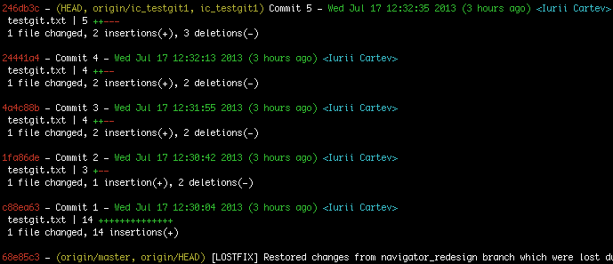
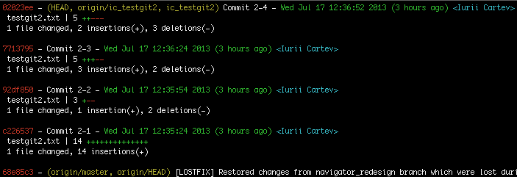
Scenario for all examples:
Imagine we’ve created 2 branches from same point of master and introduced number of changes to each of them (to different files):

Slide 7
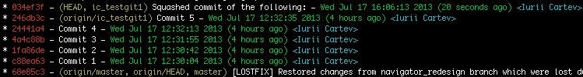
Example of merge squash:
Merging branch 2 into 1 using squash:
> git checkout -b ic_testgit1
Switched to branch 'ic_testgit1’
> git merge --squash ic_testgit2 -m ‘Squashing commits of the following: .....’
[ic_testgit1 034ef3f] Squashed commit of the following:
1 file changed, 13 insertions(+)
create mode 100644 testgit2.txt
> git log
Note: As you see, there is new commit (new hash), new timestamp and new comment. There is no branch info, and same author for whole commit. Blame is useless here.

Slide 8
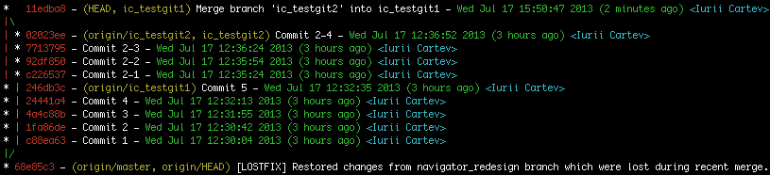
Example of merge (no squash):
Merging branch 2 into 1 without using squash:
> git checkout -b ic_testgit1
Switched to branch 'ic_testgit1’
> git merge ic_testgit2
Merge made by the 'recursive' strategy.
testgit2.txt | 13 +++++++++++++
1 file changed, 13 insertions(+)
create mode 100644 testgit2.txt
> git log --graph
Note: Pay attention that everything left intact (timestamps, authors, etc.) Also it has branch information, so you can see when it started and ended. And blame is extremely useful.

Slide 9
3. Continuous merge & talk
Merging or rebasing often is very useful. Personal branches should be rebased every day. Feature branches (with more than 1 person contributing) should be merged every day or two.
While resolving a conflict, consider not only the change itself, but also use “git blame” on each of two branches to see author and timestamp of the change. Example: logic is changed and old-known method param is removed, but person who merges knows that this param was always used, thus leaves it in merged version.
If any unknown conflict arises, corresponding developer should be asked right away. It’s better to do then to have several new bugs introduced.
Any conflicting feature branch merge/rebase should be reviewed by devs who contributed to it. Would be good if they indicate their review in an e-mail.

Slide 10
4. Rebase / cherry-pick + merge
Do not cherry pick from branch A to branch B if you plan to merge these branches later. Cherry-pick applies a patch in a NEW commit, thus new hash, new timestamp (although author stays the same), therefore while merged, it will be listed in commit history as duplicated commit (and may override some changes if possible conflict not resolved properly)
Avoid rebasing branch B with branch A if another branch C was merged (after you branched off from A) into B and later will be merged into A as well. Reason is the same – if you later plan to merge branch B and A, you’ll have duplicated commits, because each commit rebased (after fork point) is logged with new hash and new timestamp.
Example: branch A has commit 123, branch B(from A) has 123,456, branch C(from A) has 123,789. You merge C into B, now B has 123,456,789. You introduce new change XXX to branch A, now A becomes 123,XXX. You rebase B with A, now B becomes 123,XXX,888(former 456),999(former 789). You merge C into B, now B becomes 123,456,789,XXX,888(former 456),999(former 789). So 456 and 789 are duplicated.

Slide 11
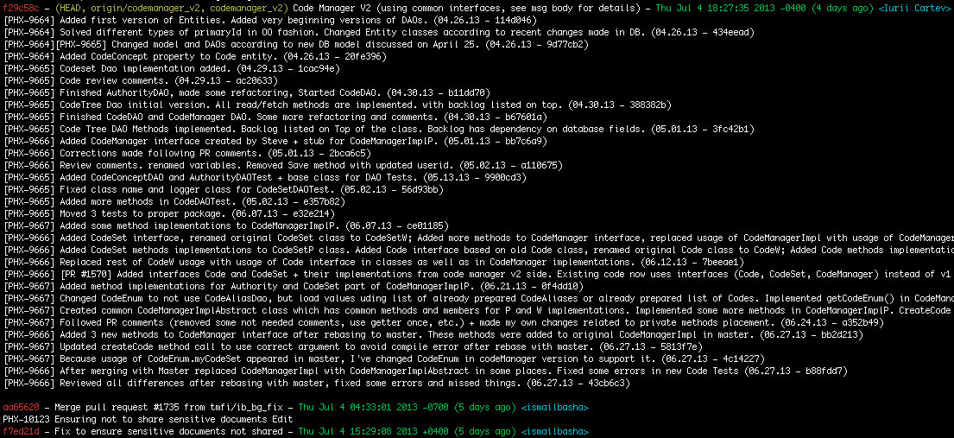
5. Squash inside your branch
It’s possible to squash several commits into one inside same branch. Here is example of one commit which I have for Code Manager V2:
Note: as you see, regardless of that development started in May, code manager v2 was last rebased on July 4 and it has one commit with all needed information. HOWEVER, such big commits should not be a permanent rule. Commits should be combined by logical parts. I’ve used one commit here only because code manager changes are made across the board, therefore rebasing each commit was a nightmare.

Slide 12

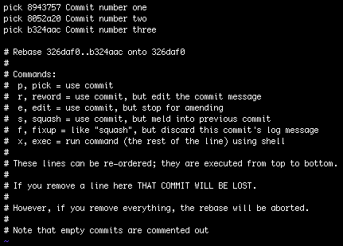
To squash 3 commits into one in your branch you need:
> git checkout ic_feature
> git log
> git rebase –i 326daf0
Note: comment is very clear, we just need to replace pick to whatever we want. In our case we want to squash 8052a20 and b324aac into 8943757, so replacing two “pick” with “squash”.

Slide 13

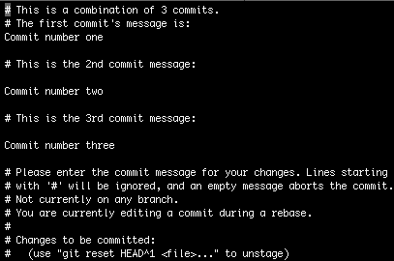
:x to save and exit
Note: This is message for our main commit. We need to describe all we did here and save (:x) to proceed with rebase.

Slide 14
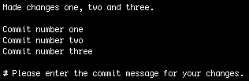
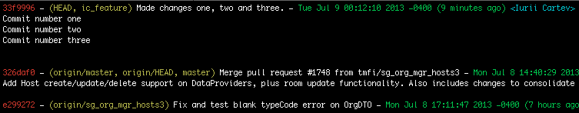
Note: First line becomes commit message subject, all the rest – commit message body.
:x to save and exit
[detached HEAD 33f9996] Made changes one, two and three.
1 file changed, 109 insertions(+), 18 deletions(-)
Successfully rebased and updated refs/heads/ic_feature.
> git log
Note: For my feature I don’t need several commits since I know I’m working on it by myself. But I am saving valuable time because next rebase won’t go through each commit and merge to other branch won’t have too much redundant commits.

Slide 15
6. Tagging master for releases
Release-v4-4-2-7 branch is merged to master from time to time as well as master is merged to it. If all we care about is point in time when release started, then we could just tag master branch and continue working in it.
In this case all branches with features for next release should be merged to master only after its tagged with next release version.
Info on GIT tagging can be found here: http://git-scm.com/book/en/Git-Basics-Tagging

Slide 16
Using commit --amend
If you just committed some changes into your branch and realized that you forgot to add something which can be a part of the commit you just made or you just simply want to correct your comment, then instead of creating new commit, try “git commit --amend”. It will append your current changes to previous commit and create a new commit instead of existing one.
Be aware that if you already pushed a branch to origin before making an amended commit, you’ll need to force push the new version because branches will be diverged (have different commits), therefore take it in consideration when working on a branch with other people.

Slide 17
7. Using initials for personal branch
Dan had a very useful rule in his “GitHubTraining” video – he asked to always prepend your personal branch name (i.e. the one only you contribute to) with unique initials or short name. Not just include, or append like “patient_alert_john_9596”, but put it first.
Reasons for it are sorting(your branches will always be together) and autocompletion(when people type “pati” and press Tab, only common feature branches are displayed)
Example: ic_PHX-123_PatSorting, ic_PHX-456_RoundsCount, etc.

Slide 18
8. Generating Release Notes
When we get rid of commits like “merge” or “code review changes” and have only commits like: “[PHX-123] Fixed NullPointerException in PatientSearch”, we may want to create a script for generating release notes based on commit history. These documents per releases may be useful for us for future reference.
Example (every note includes hash, date, author, subject and body):
af94196 - Thu Jul 11 04:15:25 2013 <U-OHUM\sumeetc>(sumeetc@lpt0036.OHUM.COM)
Fix for issue PHX-10302 (Messages received from patient should be under "Patient messages" header)
Also modified the Section Labels as per the, Requirement Redesign Requirement. page Number: 32 • If Sort by Type, Display headers for generic messages, display "Messages" o "Chart Messages" o "Patient Messages" o "Laboratory Results" o "Diagnostic Imaging" o "Clinical Notes" o "Alerts" o “Documents”
986035c - Wed Jul 10 09:07:33 2013 <Weili Yao>(weili.yao@wellogic.com)
PHX-10213 New alerts feature implemented (details come in the body which is not included in this example to save space)
e790593 - Tue Jul 9 13:28:45 2013 <Weili Yao>(weili.yao@wellogic.com)
PHX-10304 Added logic to support duplicate messages/tasks in one fetch
etc.

